Slide 1
Pivot Table Tutorial

Slide 2
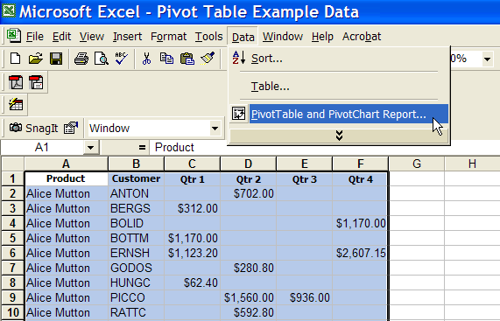
Step 1
From the “Data” toolbar menu, choose “PivotTable and PivotChart Report”

Slide 3
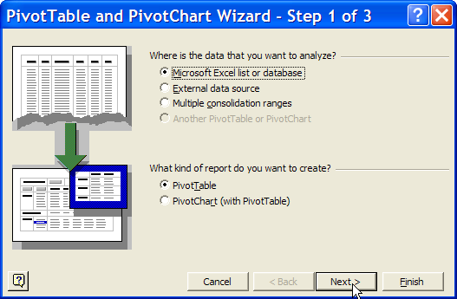
Step 2
For our purposes, the Wizard’s default settings are appropriate
Click “Next” to continue

Slide 4
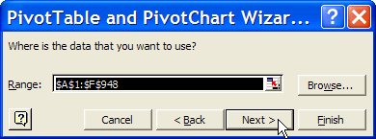
Step 3
Excel will attempt to guess the range of the data that you want to use in the Pivot Table. If correct, click “Next”
To select a different range, click on the small box to the right of the blackened “Range” box

Slide 5
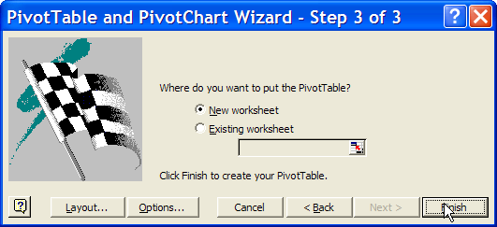
Step 4
Choose where you want the Pivot Table to appear. A new worksheet is usually the easiest with which to work. Click “Finish” to continue

Slide 6
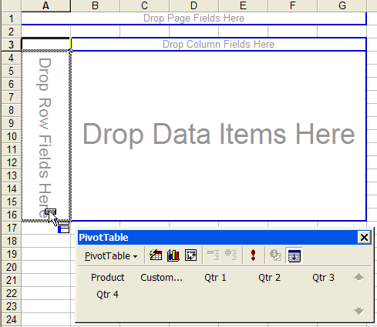
Step 5
Populate the row fields by dragging the appropriate data item to the “Drop Row Fields Here”

Slide 7
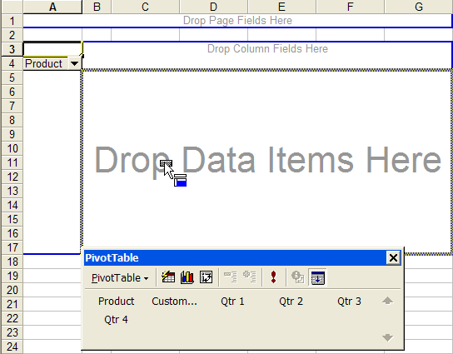
Step 6
Next, populate the data area by dragging a data item into the area “Drop Data Items Here”

Slide 8
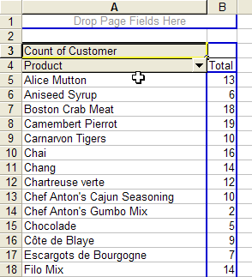
Results
In this example, the rows are the product types and the data (appearing in the next column) is a count of the number of customers who bought this product

Slide 9
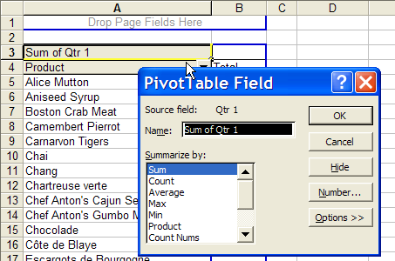
Step 7
We can choose a different data summary by double clicking on “Count of Customer” and selecting the desired summary method

Slide 10
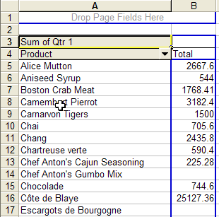
Result
In this case, we have used the data field “Qtr 1” and changed from count to sum to give us the total number of dollars of each product purchased in the first quarter

Slide 11
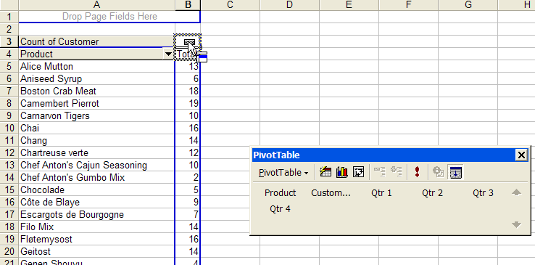
Step 8
To view each customer’s purchases of the individual products, drag “Customer” data to the area of “Drop Column Fields” which now appears as an empty box above “Total”

Slide 12
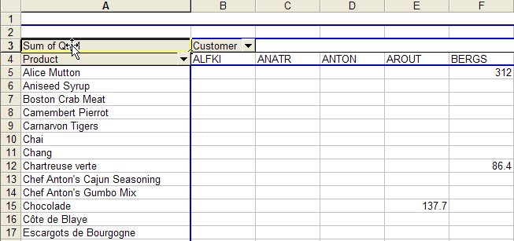
Result
We now have the dollar of amount of each customer’s purchases of each product
Note that the sum over the first quarter has become irrelevant since each customer’s purchases are already summed over the quarter

Slide 13
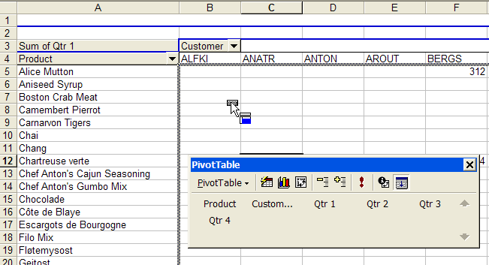
Step 9
We can add another data field by dragging another data field into the data area

Slide 14
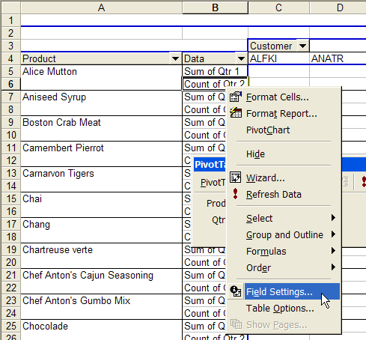
Step 10
We can change the data summary of the new field (in this case “Count of Qtr 2”) by right clicking on the appropriate data field and choosing “Field Settings”

Slide 15
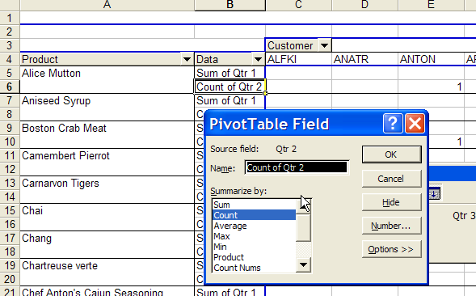
Result
The result is the same data summary menu as we saw in Step 6

